Slide 1



Quantium – Store Layout Trial Analysis
Customer Analytics & Experimentation for Strategic Retail Decisions
Presented by: Ritesh Gupta
8010211665
riteshshahofficial1@gmail.com

Slide 2









Project Overview
Objective
Scope
Deliverables
Evaluate the impact of new store layouts on chip sales and customer behavior
Analyze customer purchasing behavior
Data-driven insights
Control store selection
Measure uplift from layout trials in Stores 77, 86, and 88
Uplift testing and recommendations

Slide 3







Task 1 – Customer Analytics
Data Preparation
Cleaned and validated QVI transaction and behavior data
Engineered Features
Built KPIs
Brand extraction from product data
Revenue, transactions, units per customer
Pack size (grams) and bucketed ranges
Segment share and penetration
Integrated customer segments: LIFESTAGE × PREMIUM

Slide 4


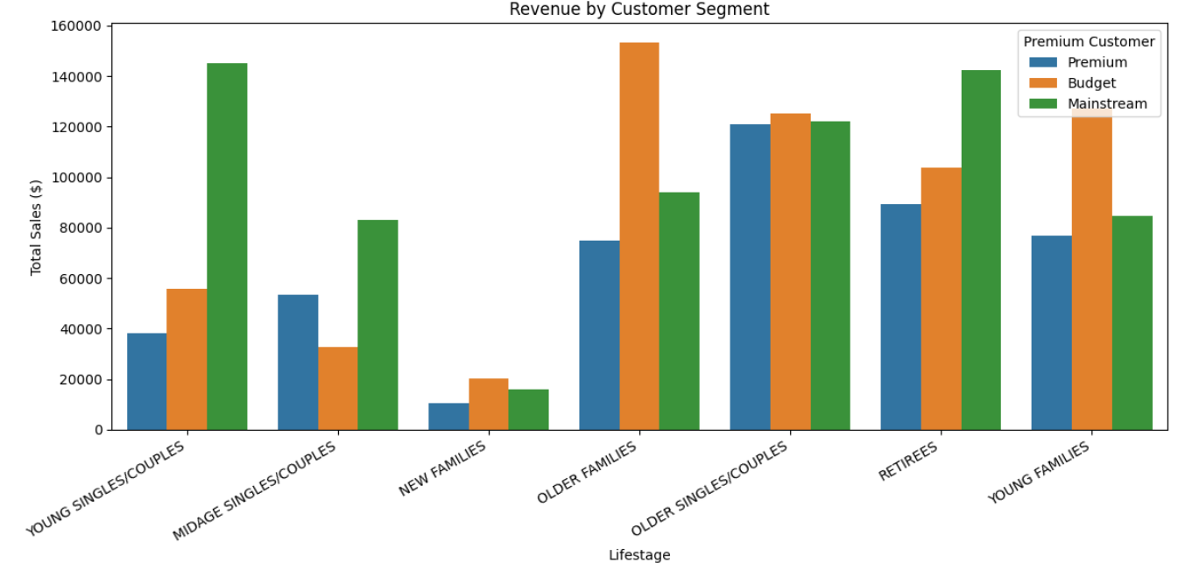


Customer Insights & Trends
Premium segments contributed the most to revenue
Revenue by Customer Segment
Mid-size packs (200–400g) were most popular
Top brands: Smiths, Doritos, Kettle
Seasonal trends observed in chip purchases

Slide 5





Task 2 – Experimentation Setup
Trial Stores
Trial Period Definition
77
86
88
Pre-Trial
Trial
Feb - July 2018
Feb - Apr 2019
Metrics Analyzed
Control Store Selection
Total revenue
Number of customers
Pearson correlation for trend similarity
Transactions per customer
Magnitude distance for performance proximity

Slide 6

Control Store Selection Results
Control stores were selected based on high correlation and low distance in pre-trial performance to ensure fair comparison.
Trial-Control Store Pairs
All correlations > 0.94, indicating strong similarity in pre-trial trends
Store 77 has the highest correlation, making it the best-matched pair

Slide 7


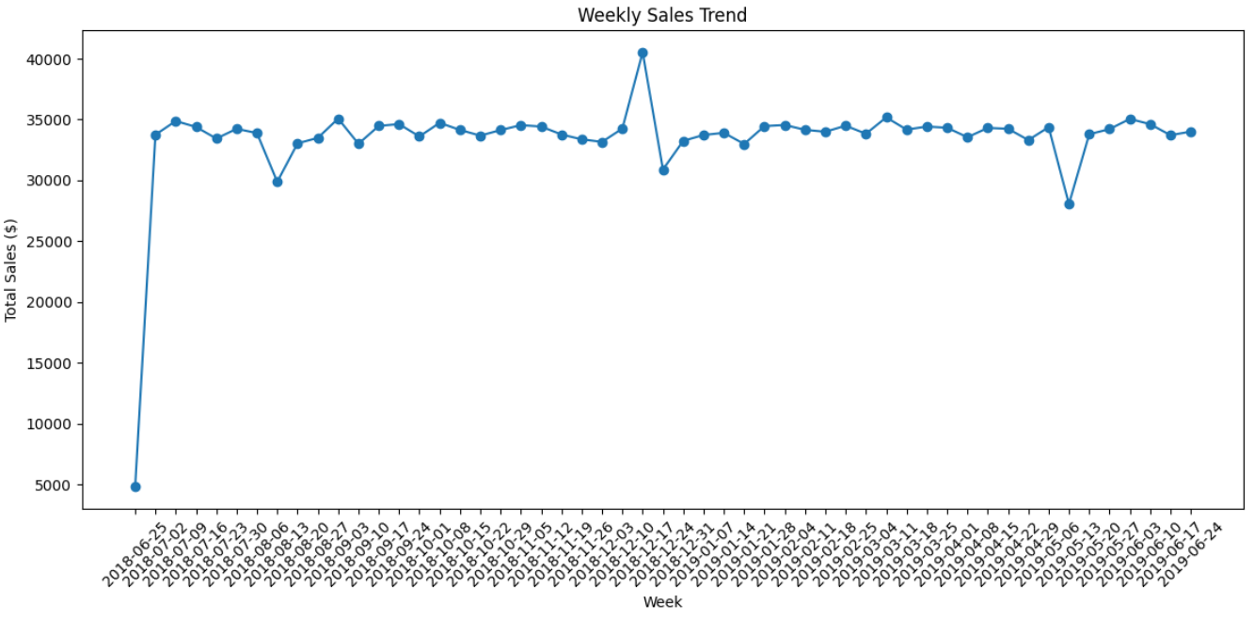
Uplift Testing & Indexing
Normalization
Weekly Sales Trend Analysis
Control store metrics normalized to match trial store baselines
Indexed Metrics
Revenue Index
Customer Index
Transactions per Customer
RI
CI
TCI
Trial Start
Trial End
Statistical Testing
t-tests conducted to assess statistical significance
Index values > 1 indicate trial store outperformed control

Slide 8







Experimentation Results
86
77 & 88
Success Story
Inconclusive Results
Significant uplift in revenue and customer count
No consistent uplift in key metrics
Statistically significant results p < 0.05
Not statistically significant p > 0.05
Clear evidence that new layout drove positive results
Layout change did not produce measurable impact
Only Store 86 showed clear, statistically significant uplift from the new layout trial

Slide 9





What Drove the Uplift?
86
Uplift Drivers
Indicates improved footfall or layout appeal
More purchasing customers
Enhanced product visibility and accessibility
Not by more transactions per customer
Not a result of increased loyalty or frequency

Slide 10
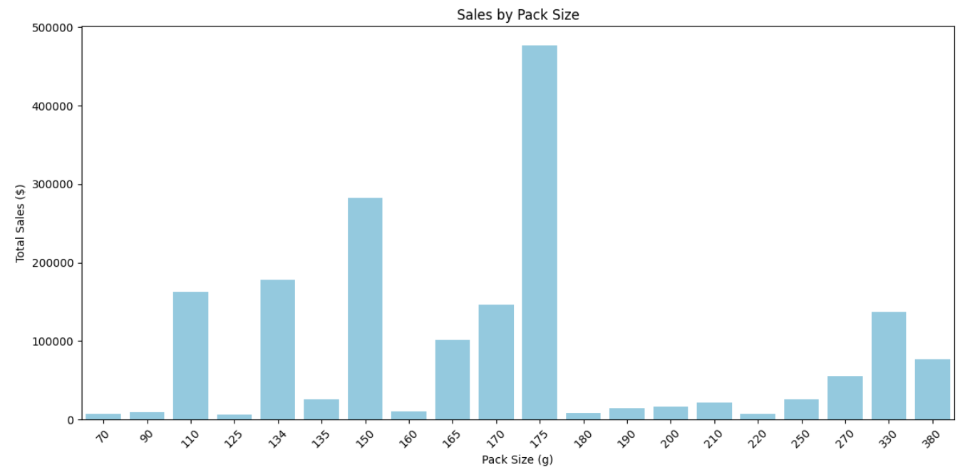





Recommendations
Roll out new layout to stores similar to Store 86
Sales by Pack Size
Further test layout in stores similar to 77 and 88
Focus promotions on premium segments and mid-size packs
Leverage seasonal trends for campaign timing
175g packs show highest sales, followed by 150g packs
Maintain reproducible analytics pipeline for future trials

Slide 11




Conclusion
Data-driven experimentation validated layout impact
Customer analytics revealed key revenue drivers
Project delivered actionable insights for category review
Store 86 showed significant uplift → rollout recommended

Slide 12


Thank You
Ritesh Gupta
8010211665
riteshshahofficial1@gmail.com

